Slide 1

Control and Coordination
CHAPTER 7 PART 1

Slide 2
Nervous System in Animals
The changes in the environment to which living organisms respond are called stimuli.
Eg :- heat, cold, sound, smell, taste, touch, pressure, gravity, water etc.
Living organisms respond to stimuli in the form of body movements.
i) In animals control and co ordination is done by the nervous system and endocrine system.
ii) In plants control and co ordination is done by chemical substances called plant hormones or phytohormones.

Slide 3
The working of the nervous system in humans
The dendritic part of the nerve receives the information
Creates a chemical reaction which creates an electric pulse
This impulse travels from the dendrite to the cell body and to the other end called the axon where it sets off another chemical reaction creating another electric pulse
Series of Pulses travel along nerves till they reach the brain or target organ
Hence it can be said that tissues are made up of a complex network of cells

Slide 4
The nervous system

Slide 5
Structure of a nerve cell
Notes:
Neuron is the structural and functional unit of the nervous system. It has a cell body called cyton containing a nucleus and cytoplasm.
It has several branched structures called dendrites.
it has a long nerve fibre called axon which is covered by a protective covering called Myelin sheath. The junction between two neurons is called synapse.
The dendritic part of the nerve receives the information and sets off a chemical reaction which creates an electric pulse
This impulse travels from the dendrite to the cell body and to the other end called the axon where it sets off another chemical reaction creating another electric pulse.

Slide 6
What happens in a reflex action?
IMAGINE A DANGEROUS ACTIVITY SUCH AS TOUCHING A FLAME
Notes:
When we touch the flame, if we take time to think about our actions and then perform them after processing the information, taking into consideration what would happen if the flame burns our skin then it would be too late.
Information like this needs to be processed quick, hence to save time, the complex process of thinking takes place in the tissues itself
Hence the nerves that receive the signal that the flame is in contact with the skin is directly in contact with the nerves which perform simple muscle movements.

Slide 7
Notes:
Such a connection is called a reflex arc.
Reflex arcs have evolved in animals because the thinking process in humans is not fast enough. In fact many animals have little or none complex network for thinking

Slide 8
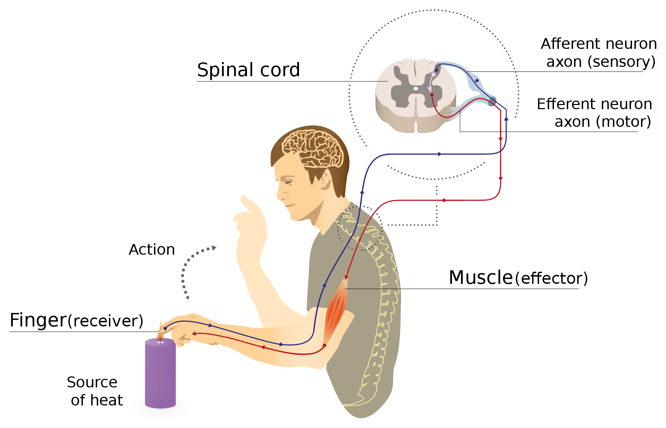

Slide 9
The Human Brain
Notes:
Fore brain :- consists of the cerebrum and olfactory lobes. It is the thinking part of the brain and controls voluntary actions. It controls touch, smell, hearing, taste, sight, mental activities like thinking, learning, memory, emotions etc.
ii) Mid brain :- controls involuntary actions and reflex movements of head, neck, eyes etc.
iii) Hind brain :- consists of cerebellum, pons and medulla.
Cerebellum :- controls body movements, balance and posture.
Pons :- controls respiration.
Medulla :- controls heart beat, blood pressure, swallowing, coughing, sneezing, vomitting etc.

Slide 10
Protection of brain and spinal cord
Notes:
The brain is made up of soft tissue which is extremely fragile, to protect this, it is in a bony box called the skull, the brain rests inside this box with a balloon of liquid around it to protect it from further shock.
The vertebral column is responsible for the protection of the spinal cord.

Slide 11
In this part of the chapter we learnt
Nervous system in Animals
Nervous system in humans
What is a reflex action
The human Brain and the spinal cord

